Slide 1
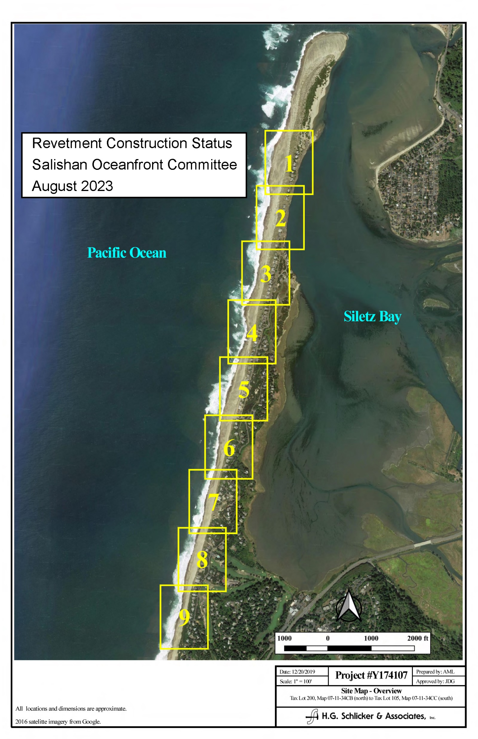
Revetment
Status

Slide 2
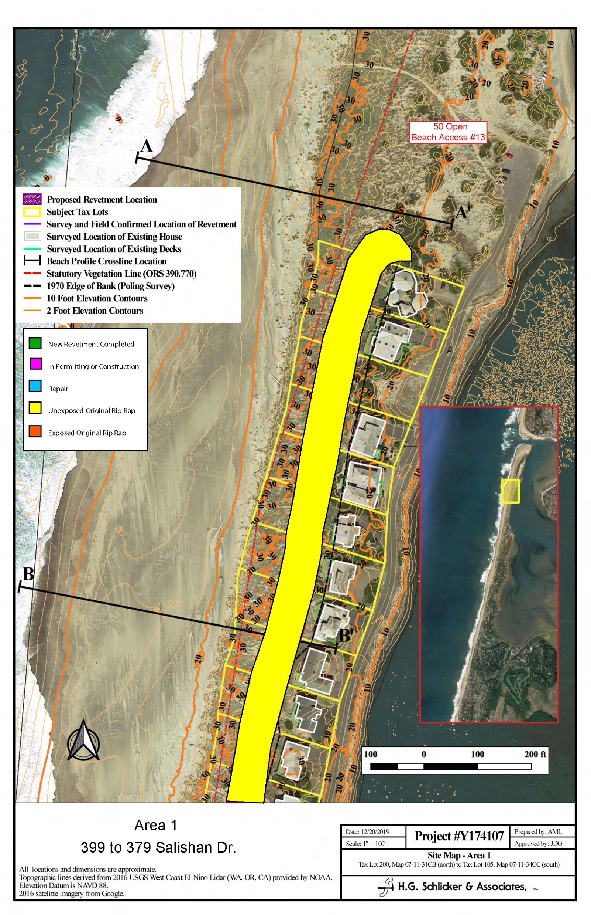
Area 1
399 to 379 Salishan Dr

Slide 3
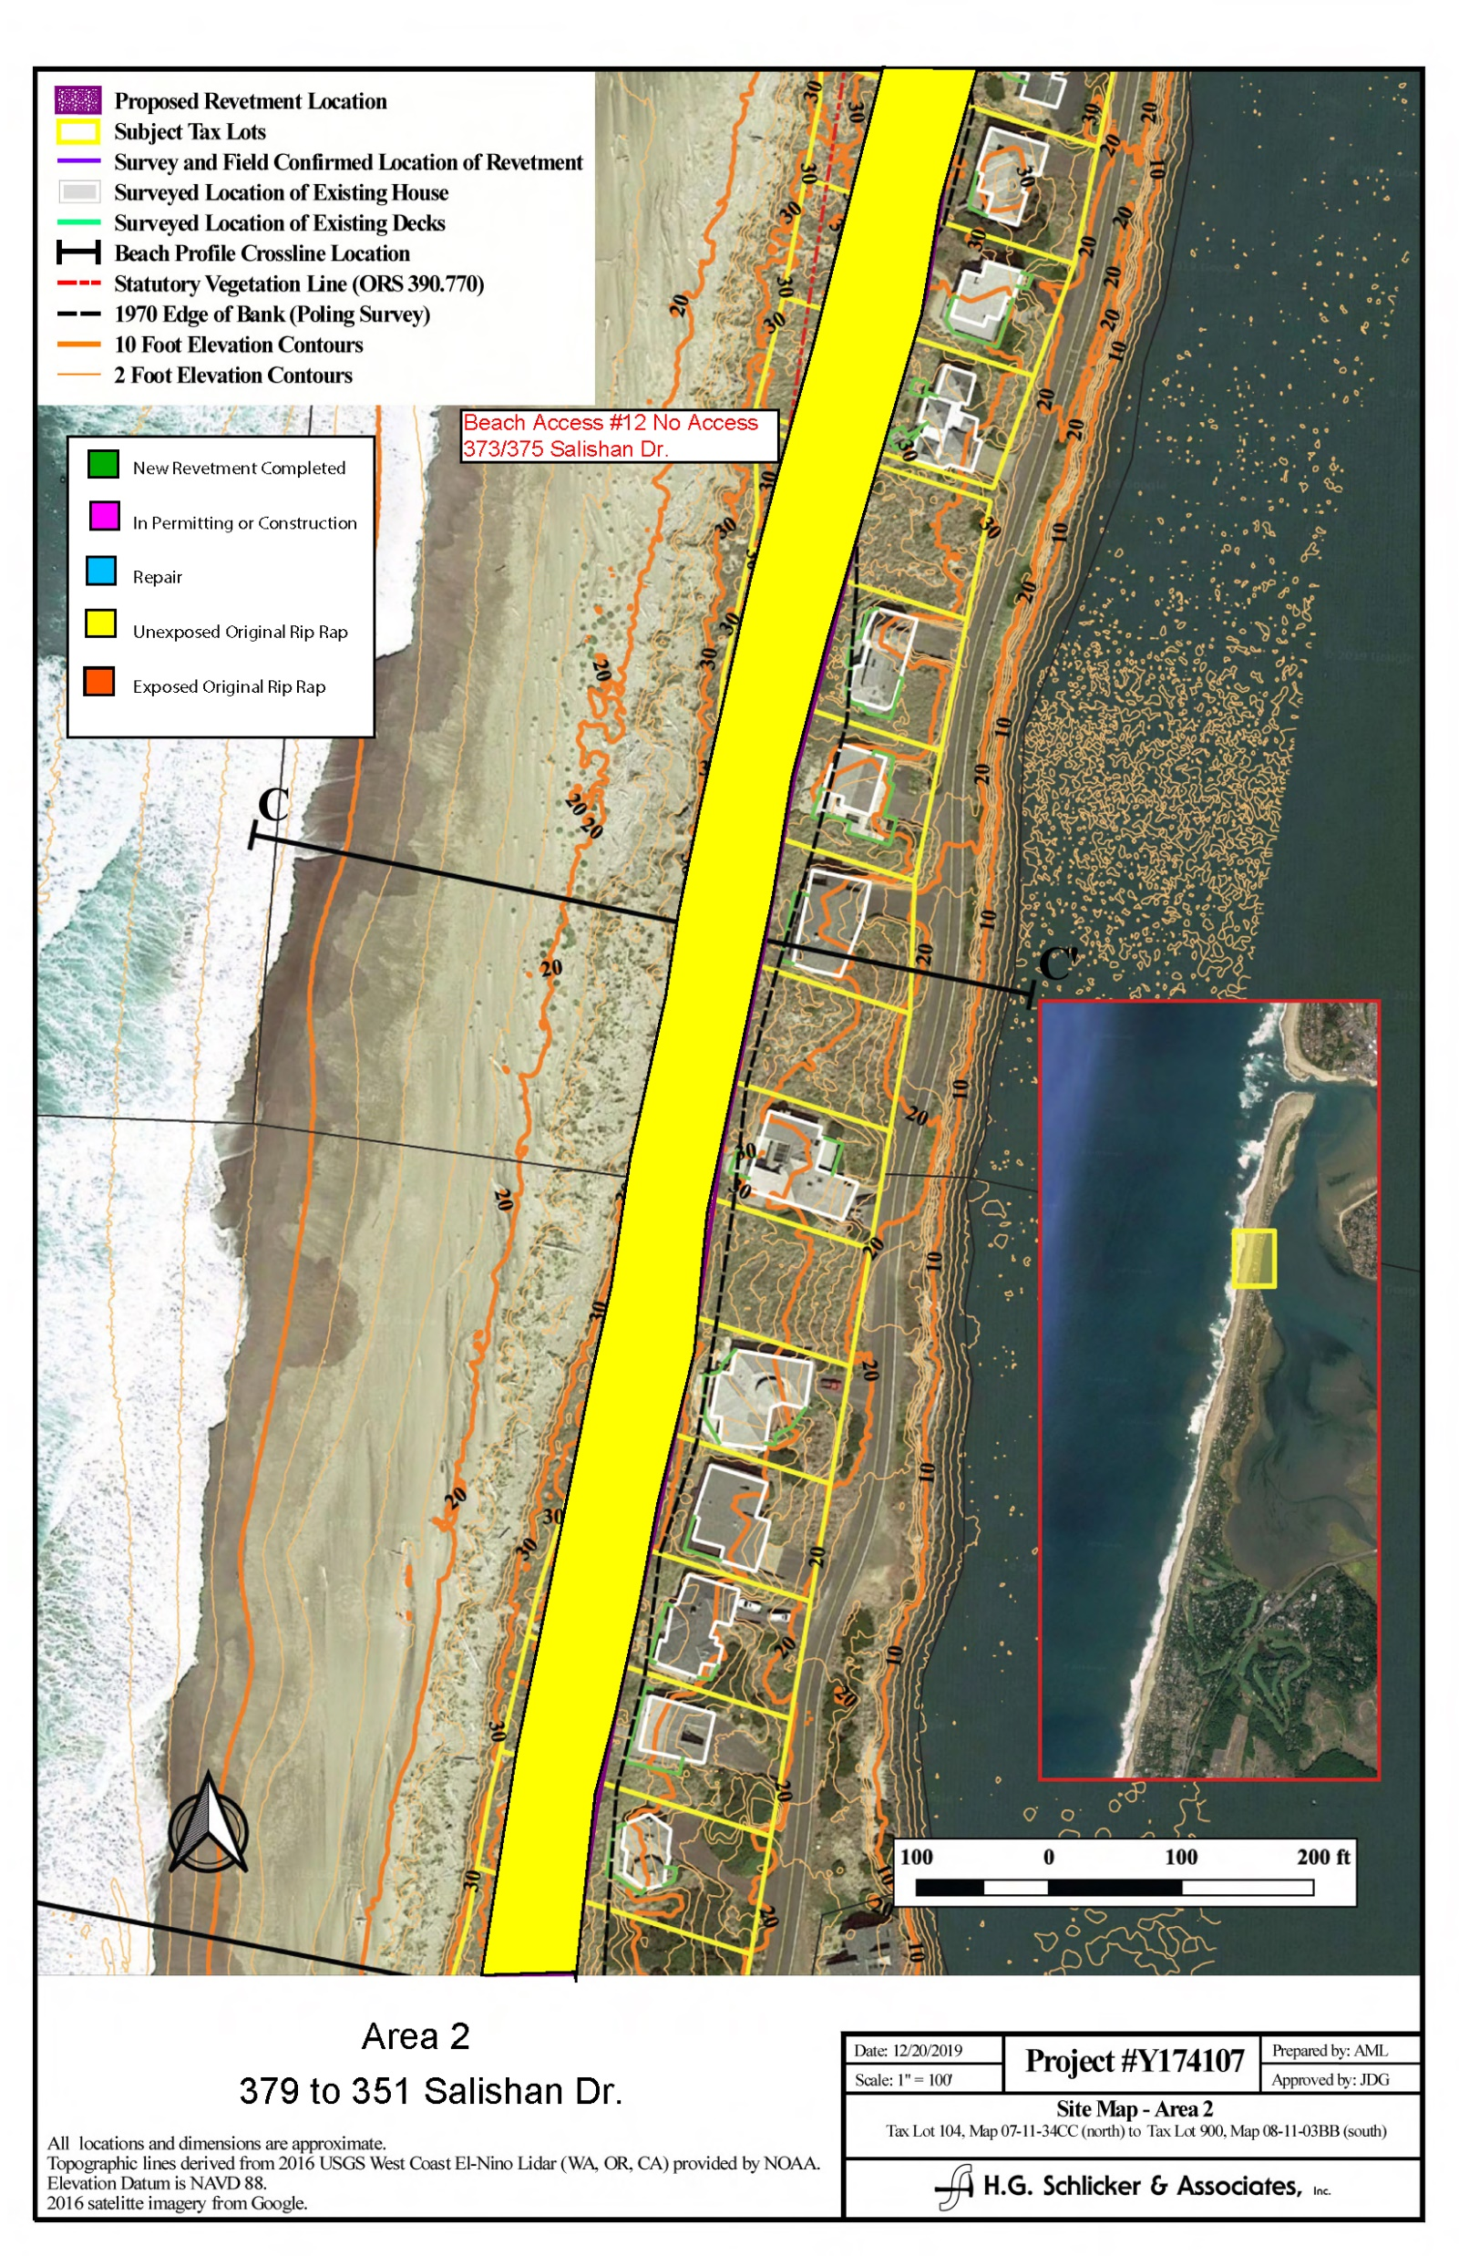
Area 2
379 to 351 Salishan Dr

Slide 4
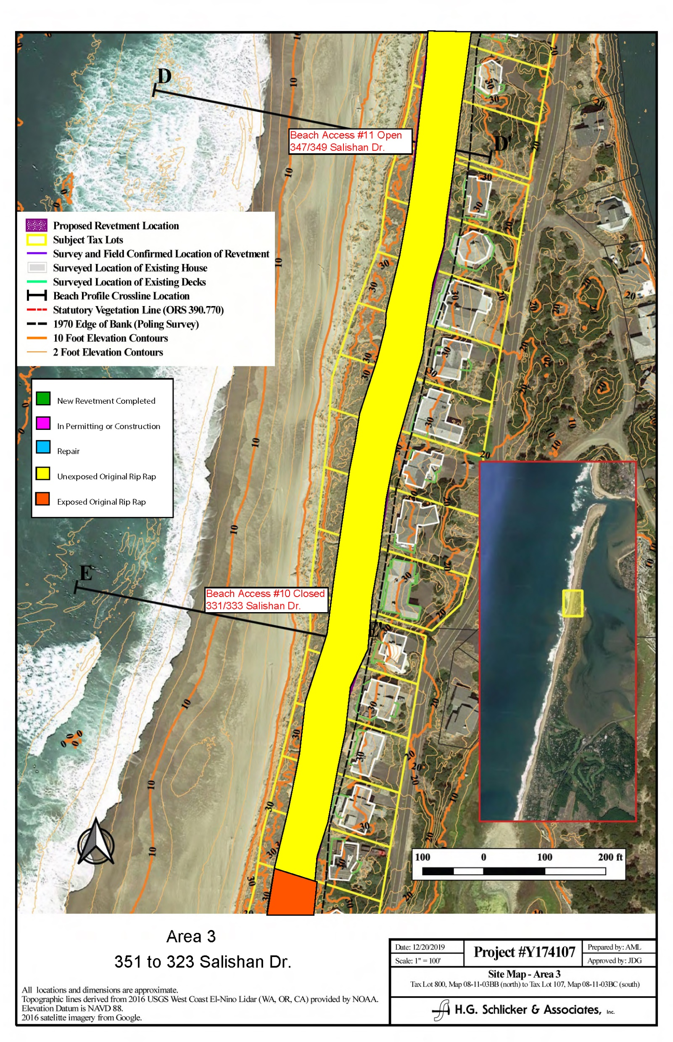
Area 3
351 to 323 Salishan Dr

Slide 5
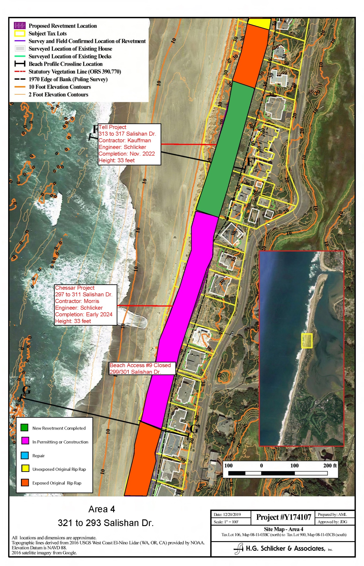
Area 4
321 to 293 Salishan Dr

Slide 6
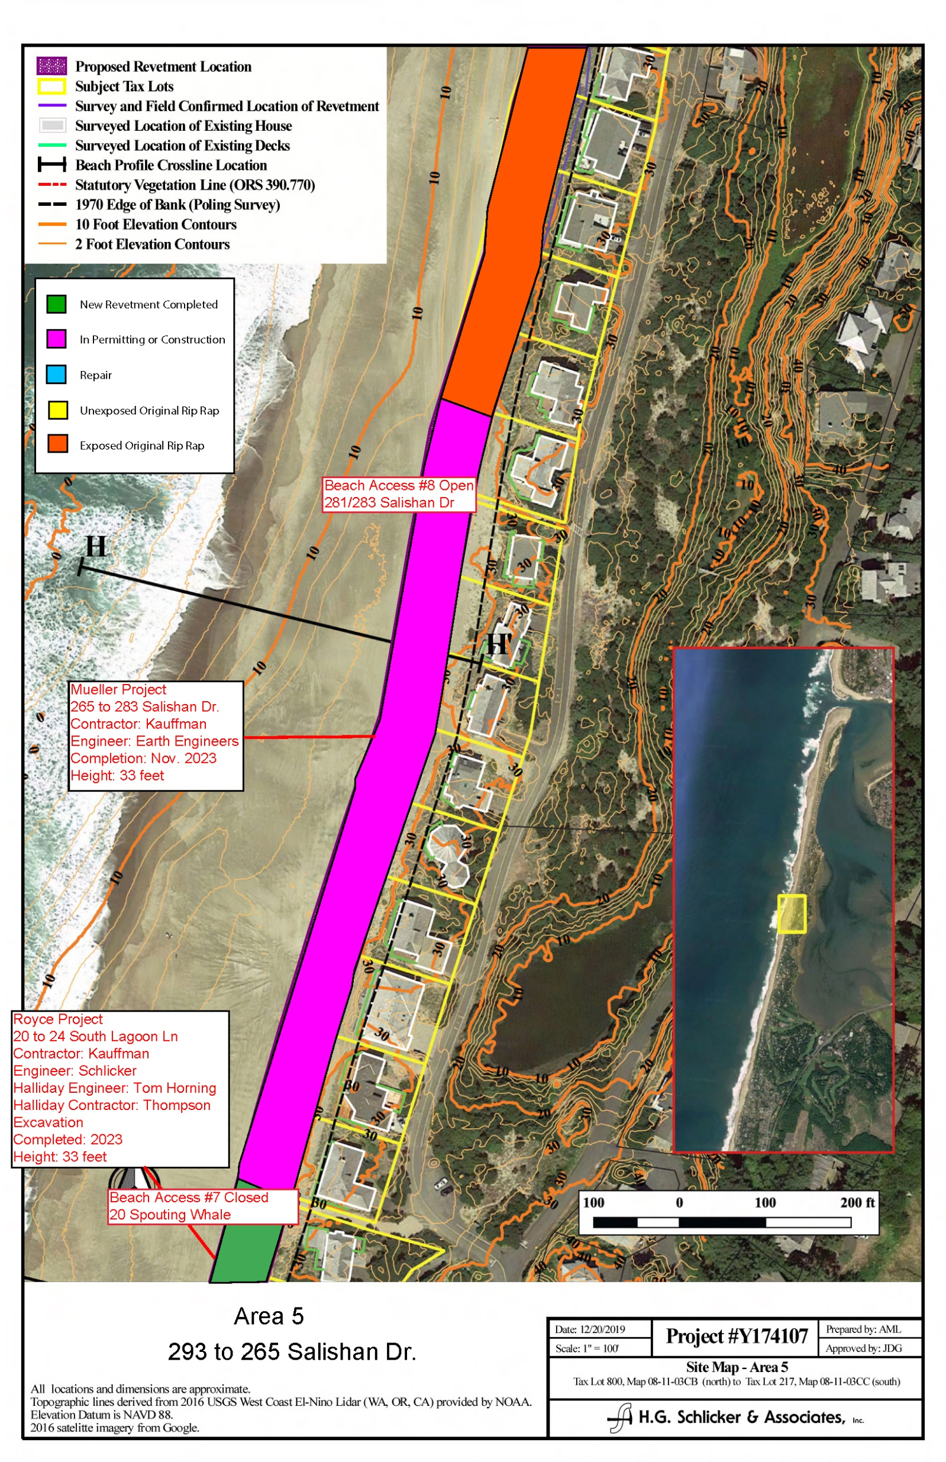
Area 5
293 to 265 Salishan Dr

Slide 7
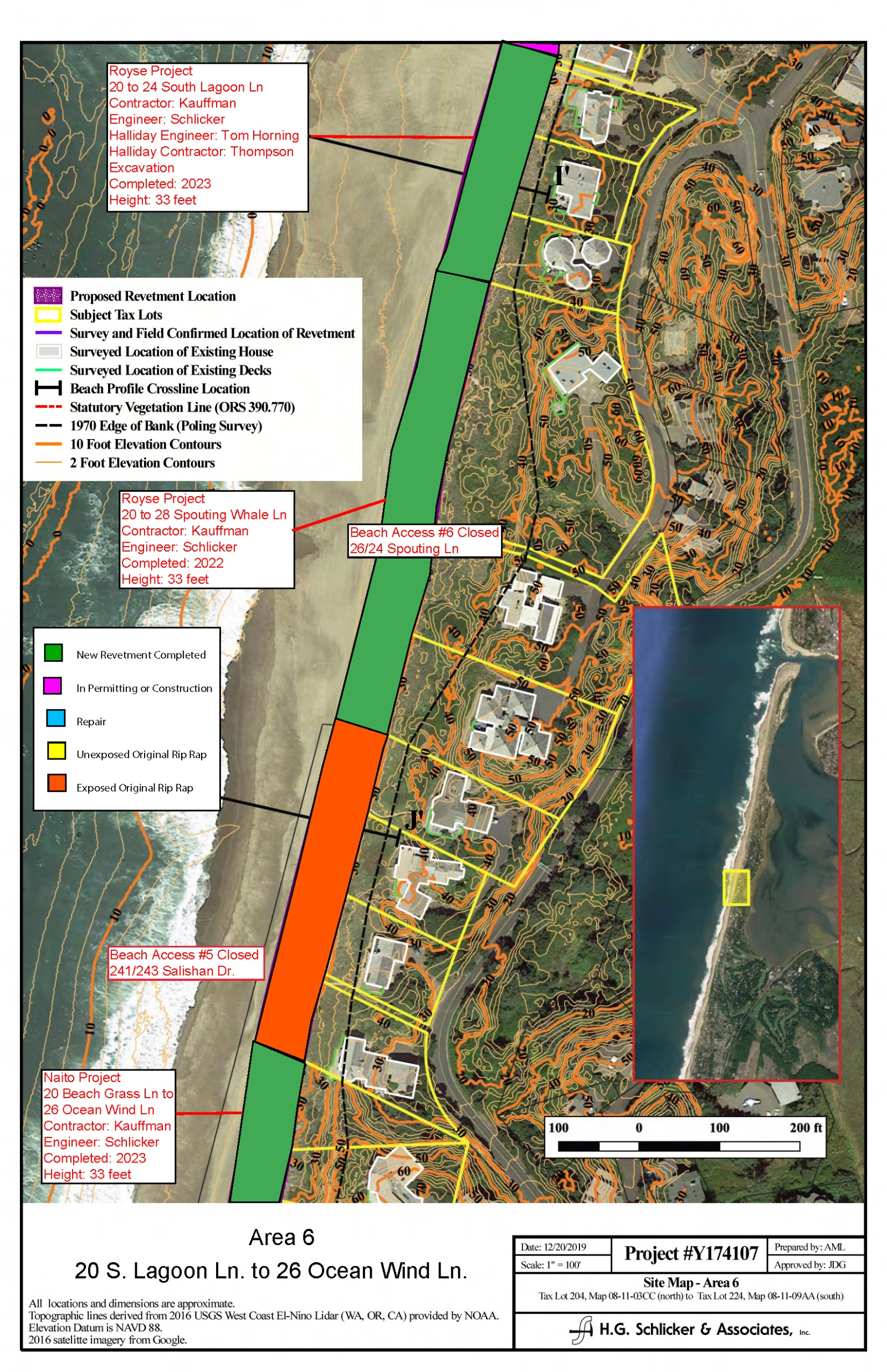
Area 6
20 S. Lagoon Ln to
26 Ocean Wind Ln

Slide 8
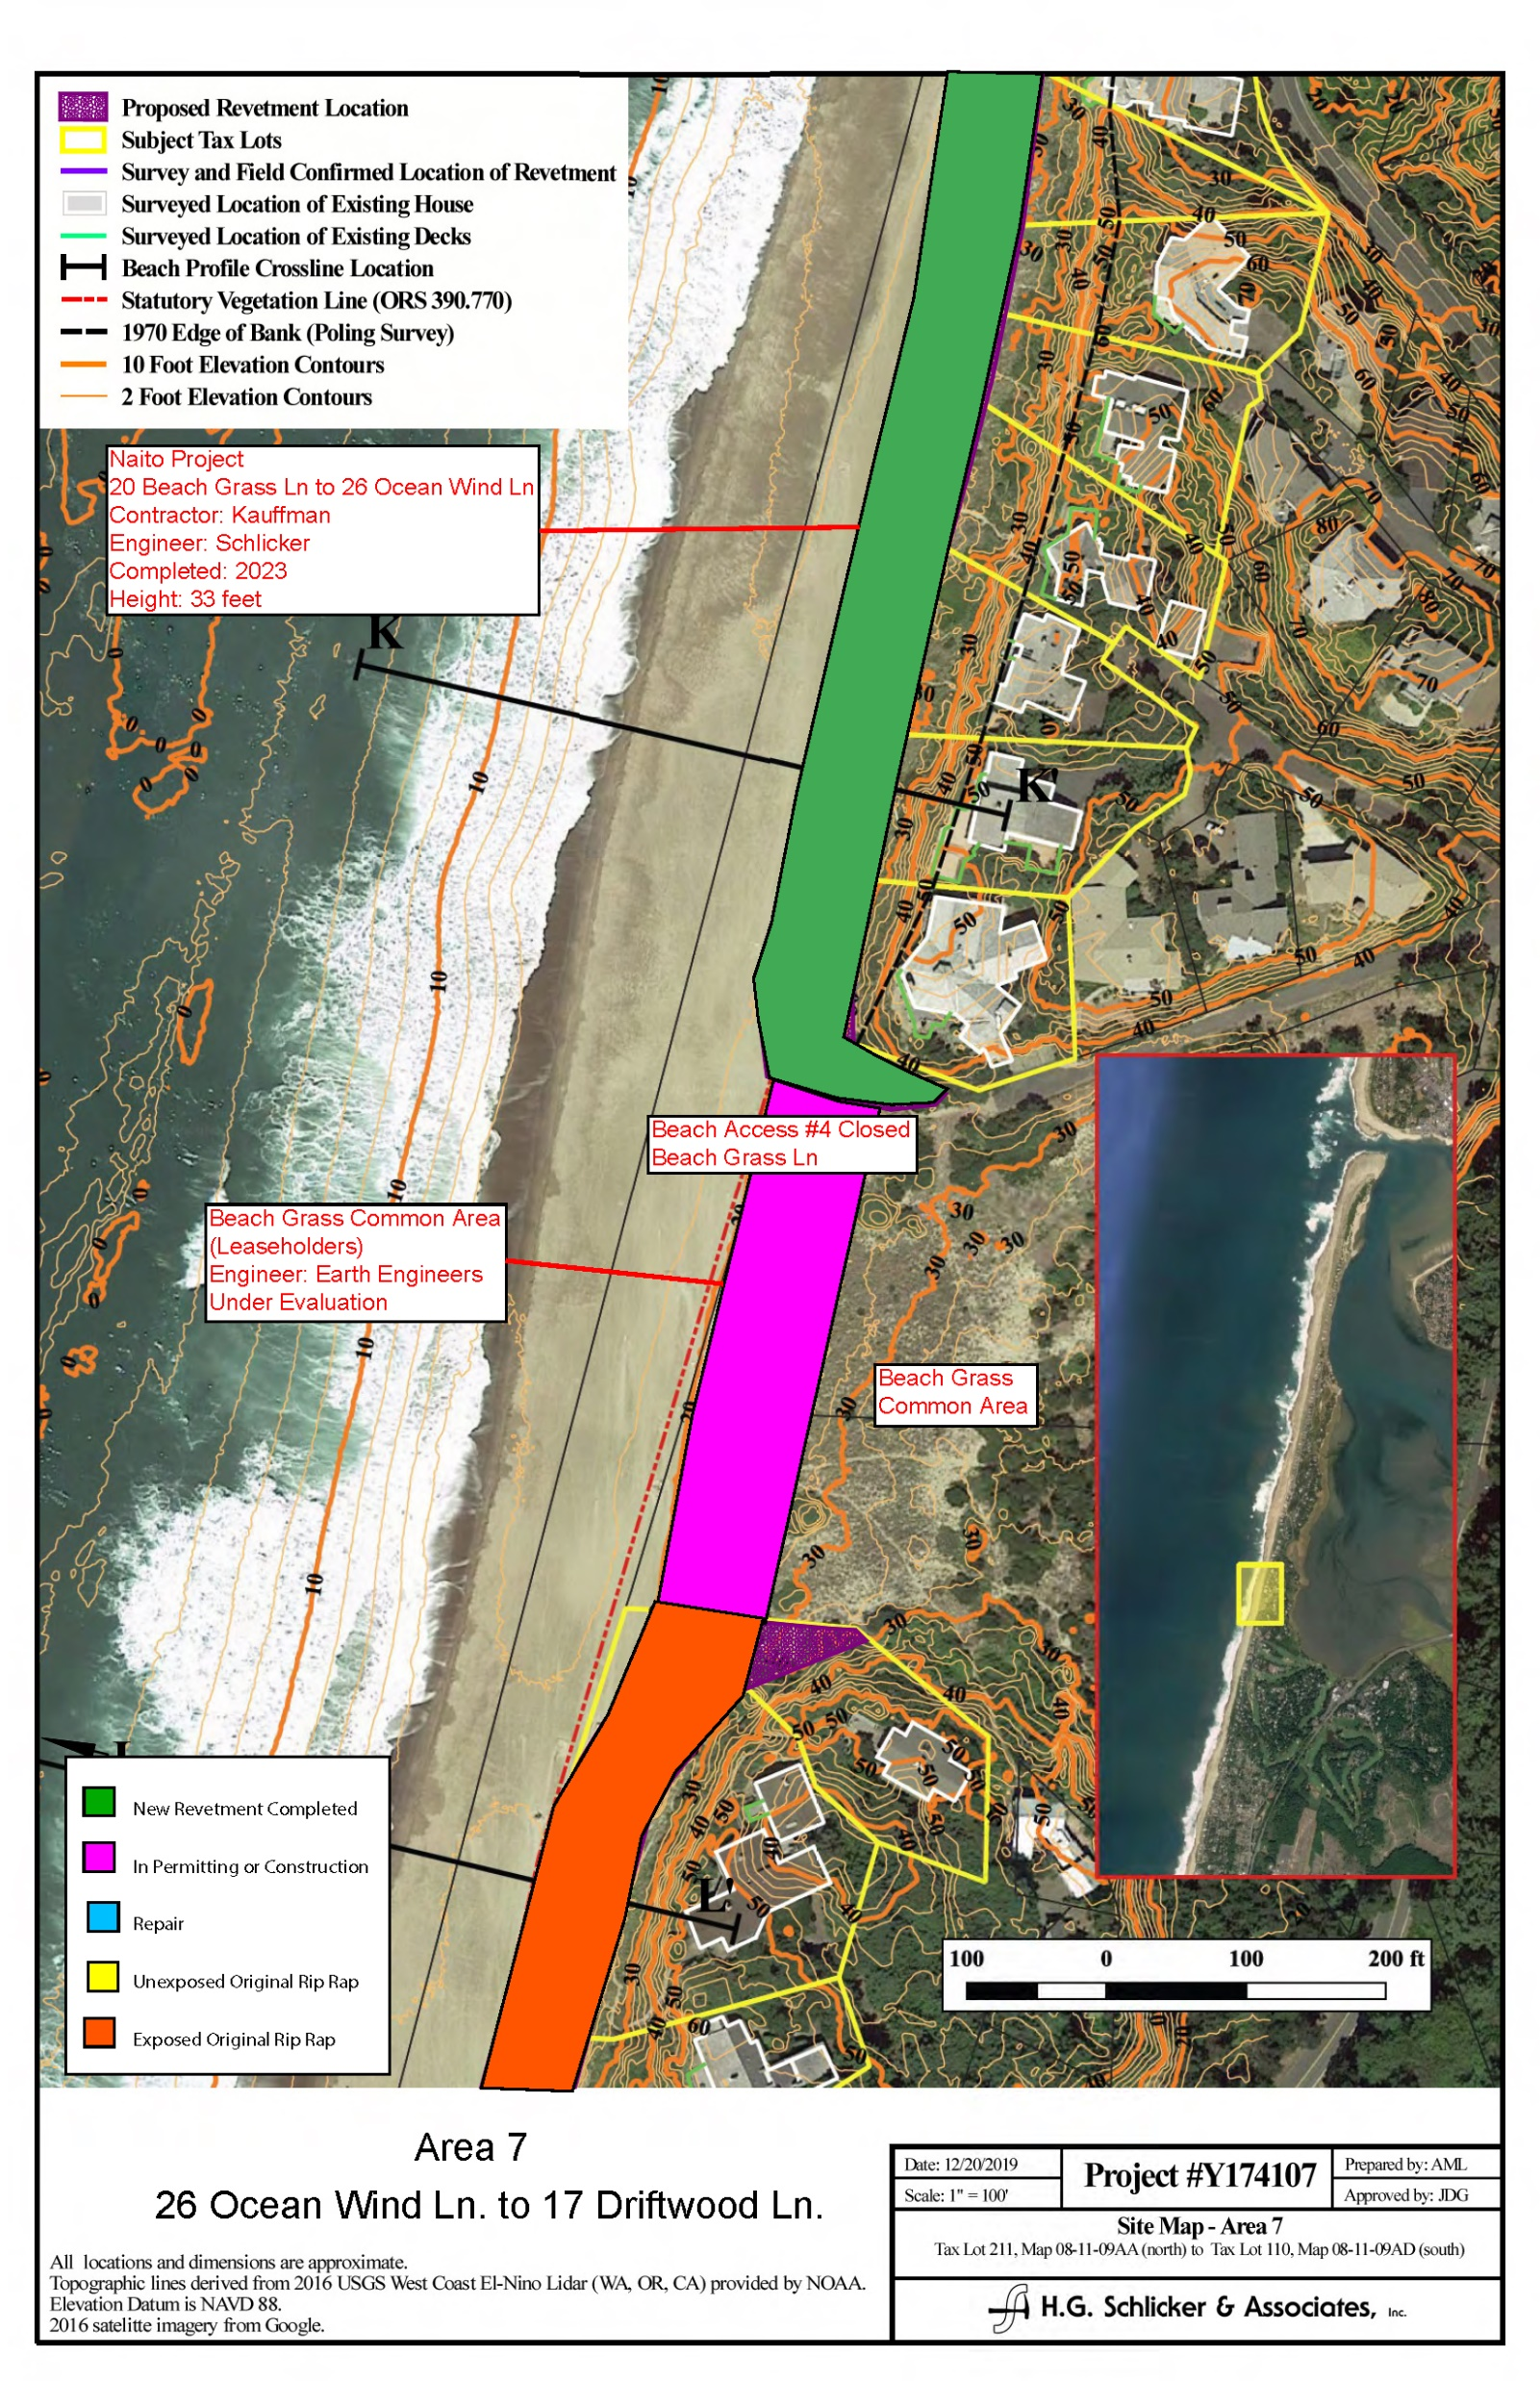
Area 7
26 Ocean Wind Ln to
17 Driftwood Ln

Slide 9
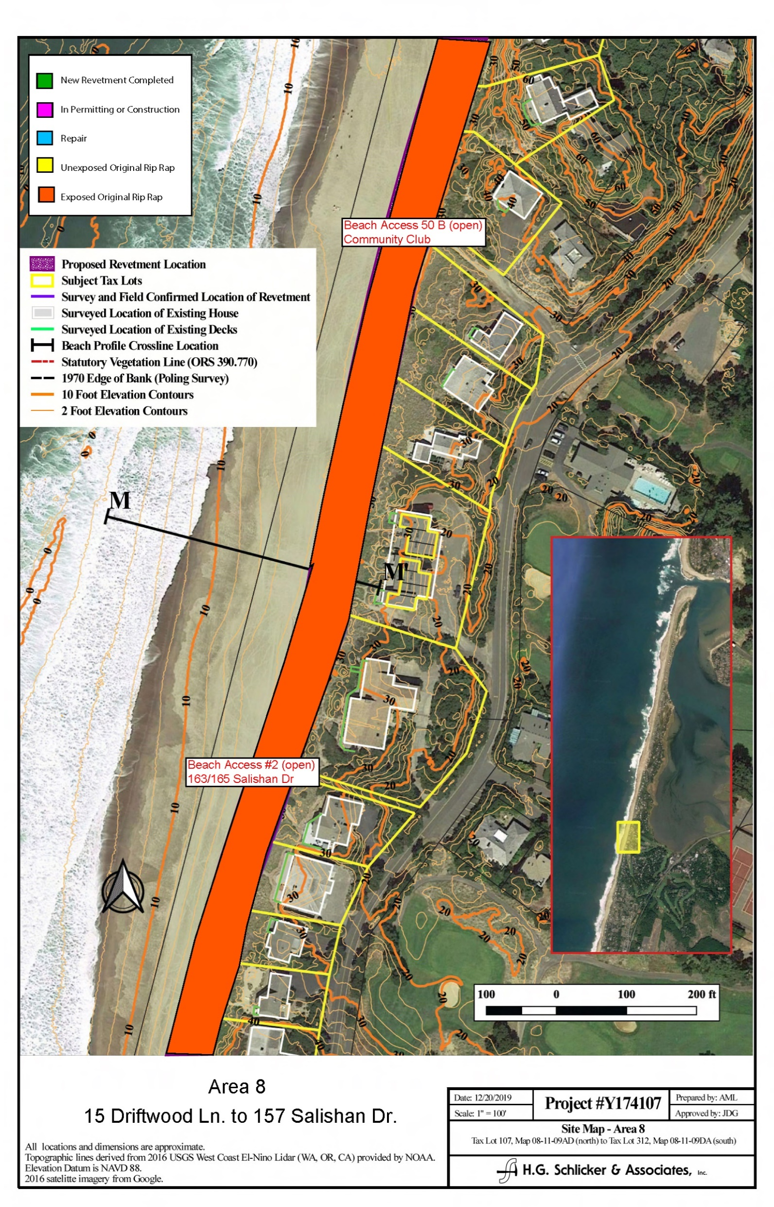
Area 8
15 Driftwood Ln. to
157 Salishan Dr.

Slide 10
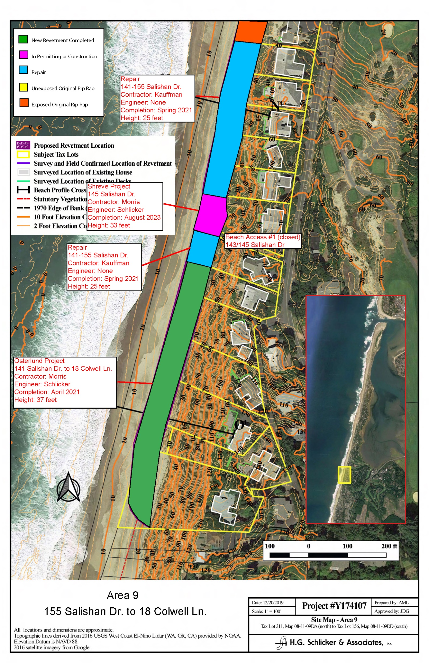
Area 9
155 Salishan Dr. to
18 Colwell Ln.

